Slide 1
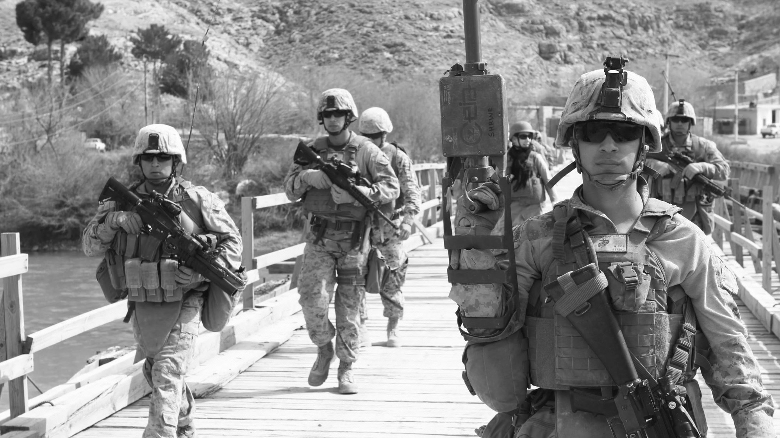
Delivering Innovation at Speed & Scale
Pete Newell, BMNT
www.bmnt.com
pnewell@bmnt.com
@ peteranewell
@hacking4defense

Slide 2
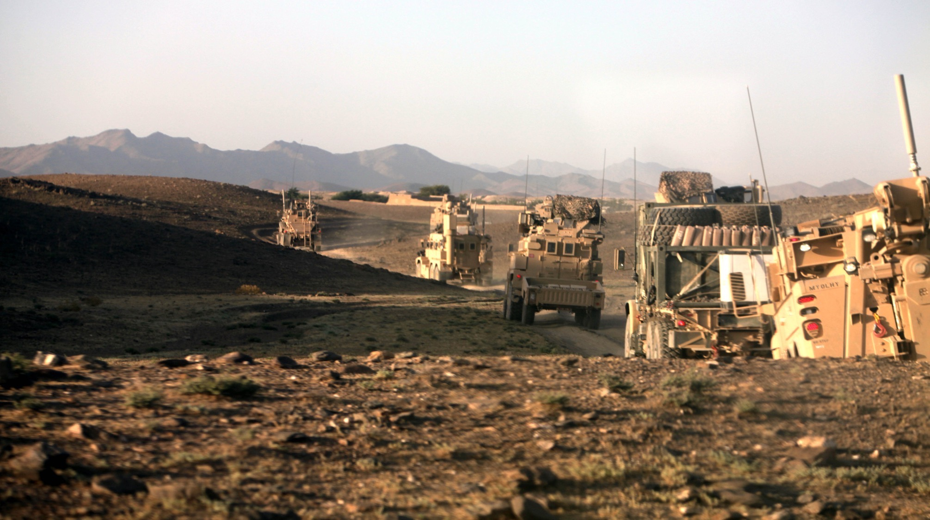

Slide 3
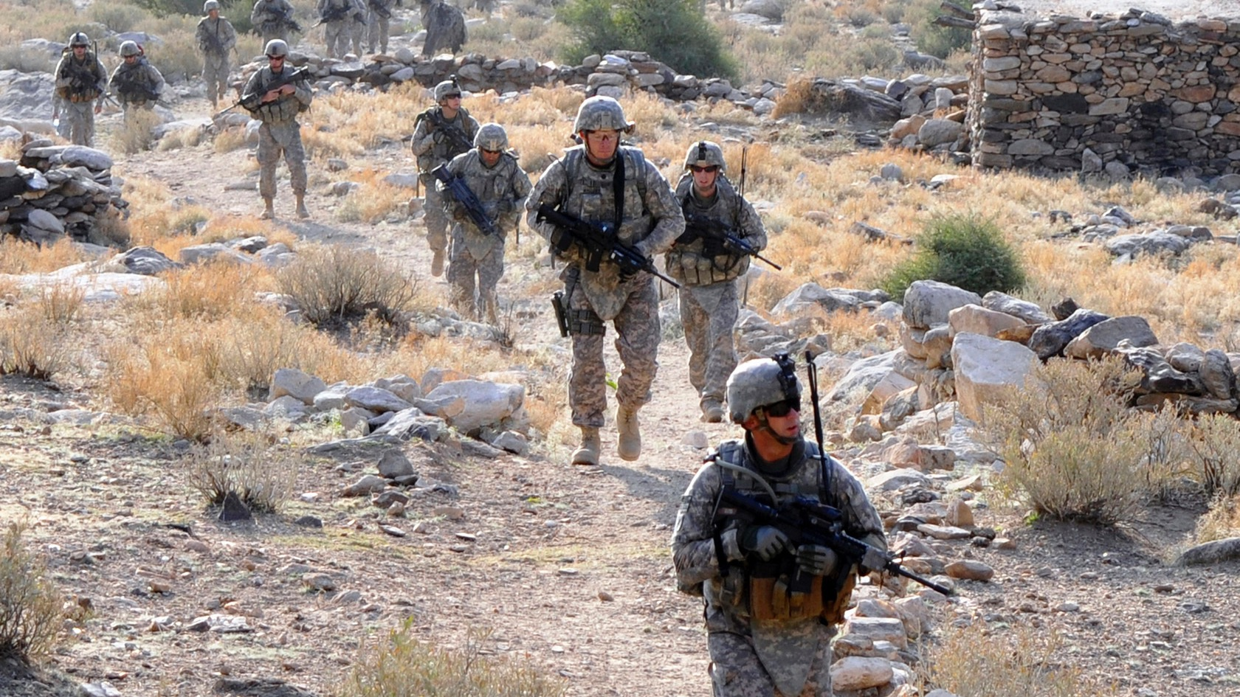

Slide 5
Solutions Delivered

Slide 6
16 Months to recognize and articulate the problem
12 more months to deliver solutions
Observe
28
Months
Act
Orient
Decide

Slide 7
Observe
8
Months
Act
Orient
Decide
Observe
28
Months
Act
Orient
Decide

Slide 8
4,896 Casualties

Slide 9
PIVOT

Slide 10
We had problems
We were not present where the problems were

Slide 11
We had problems
We were not present where the problems were
We lacked peripheral vision and we were unable to predict emerging threats

Slide 12
We had problems
We were not present where the problems were
We lacked peripheral vision and were not predictive of emerging threats
We lacked lacked a contextual understanding of the environment our problems existed in or the speed they changed

Slide 13
We had problems
We were not present where the problems were
We lacked peripheral vision and were not predictive of emerging threats
We lacked lacked a contextual understanding of the environment our problems existed in or the speed they changed
We lacked the partnerships we need to produce multiple options to solve problems

Slide 14
We had problems
We were not present where the problems were
We lacked peripheral vision and were not predictive of emerging threats
We lacked lacked a contextual understanding of the environment our problems existed in or the speed they changed
We lacked the partnerships we need to produce multiple options to solve problems
We weren’t aggressive enough, striving for solutions rather than MVP’s

Slide 15
We had problems
We were not present where the problems were
We lacked peripheral vision and were not predictive of emerging threats
We had no Pipeline for Innovation
We lacked lacked a contextual understanding of the environment our problems existed in or the speed they changed
We lacked the partnerships we need to produce multiple options to solve problems
We weren’t aggressive enough, striving for solutions rather than MVP’s

Slide 16
We had problems
We were not present where the problems were
We lacked peripheral vision and were not predictive of emerging threats
So we built one
We lacked lacked a contextual understanding of the environment our problems existed in or the speed they changed
We lacked the partnerships we need to produce multiple options to solve problems
We weren’t aggressive enough, striving for solutions rather than MVP’s

Slide 17
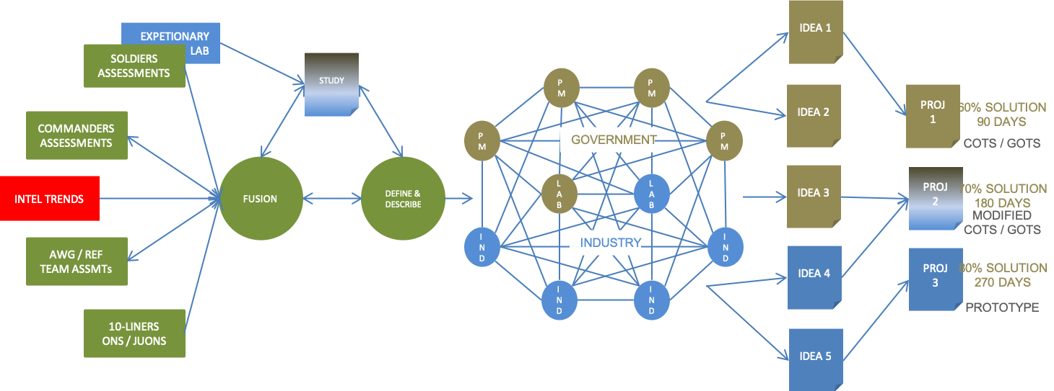
The REF Innovation Pipeline
A data-driven, disciplined system for delivering innovation at speed

Slide 18
The REF Innovation Pipeline
SOURCE

Slide 19
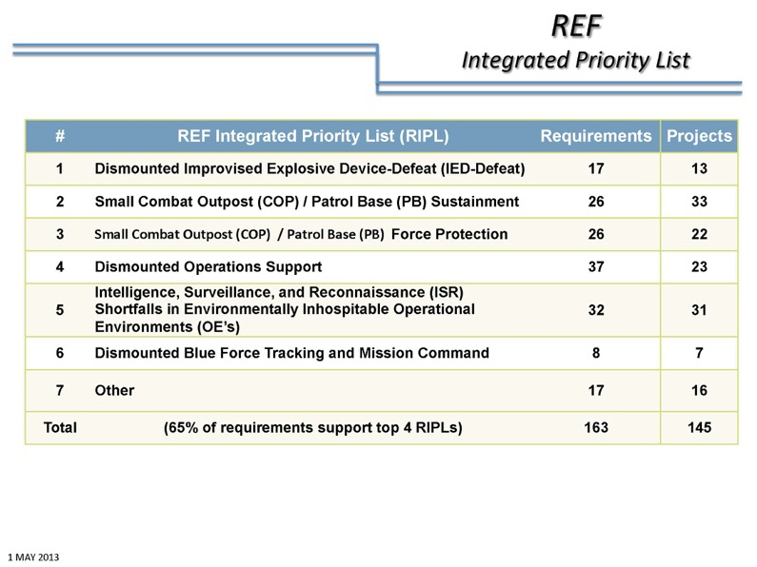
The REF Innovation Pipeline
CURATE

Slide 20
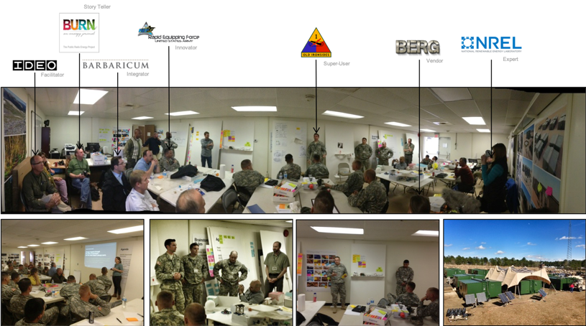
The REF Innovation Pipeline
DISCOVER

Slide 21
The REF Innovation Pipeline
INCUBATE

Slide 22
The Results
850 new problems generated

Slide 23
The Results
850 new problems generated
520 problems prioritized

Slide 24
The Results
850 new problems generated
520 problems prioritized
360 projects initiated

Slide 25
The Results
850 new problems generated
520 problems prioritized
360 projects initiated
115 solutions delivered to the battlefield

Slide 26
The Results
850 new problems generated
520 problems prioritized
360 projects initiated
115 solutions delivered to the battlefield
20 solutions transitioned to Programs of Record

Slide 27
The Results
850 new problems generated
520 problems prioritized
360 projects initiated
115 solutions delivered to the battlefield
20 solutions transitioned to Programs of Record
$1.5 Billion invested

Slide 28
The Innovation Pipeline
What we learned on the battlefield had larger implications
©2019 BMNT & Steve Blank

Slide 29
The Innovation Pipeline
Requires a disciplined, evidence-based, data-driven, process for connecting innovation activities into an accountable system that rapidly delivers solutions to hard problems
There are 5 steps in the Pipeline
©2019 BMNT & Steve Blank

Slide 30
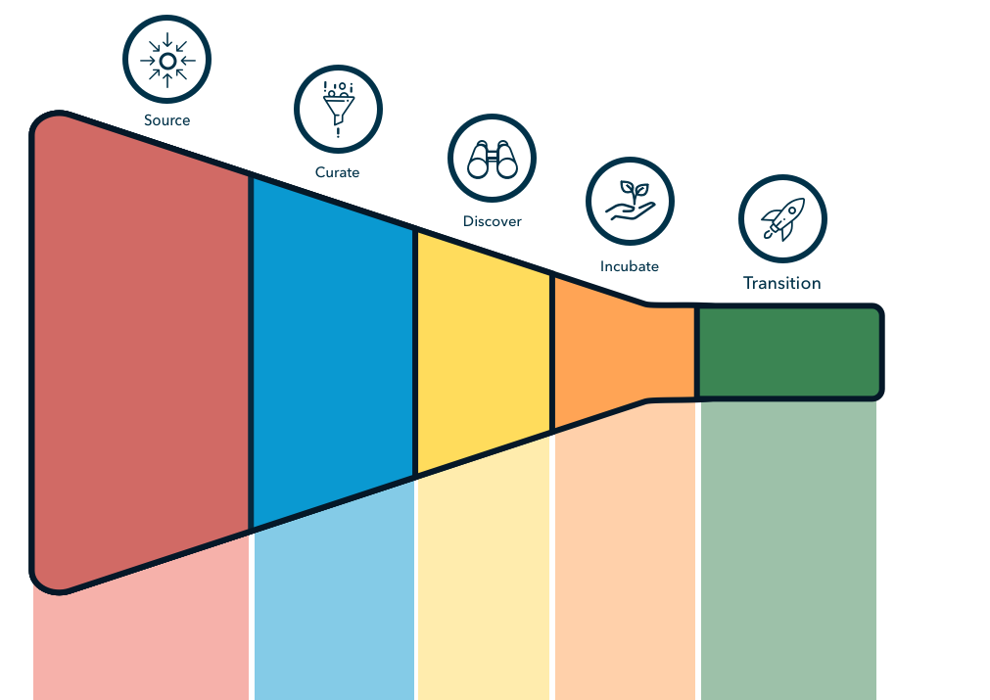
When operationalized…
the innovation pipeline creates a funnel for innovation
Ideas
Technology
Problems
People
Deployed
Solutions
©2019 BMNT & Steve Blank

Slide 31
181 GOV/COM entities engaged
H4D & BMNT
2018
EOY Snapshot
1800
People Trained
540 Problems Curated
122
Teams in Discovery
28
Solutions in
Incubation
9
Solutions
Delivered
1391 Problems Sourced
38%
23%
23%
32%
% moving forward
1391 Problems
9%
2%
.6%
% of original total
©2019 BMNT & Steve Blank

Slide 32
Each step requires it’s own support structure
Strategy
Pipeline & Infrastructure Process
Activities, Methodologies, & Tools
Metrics & Data
©2019 BMNT & Steve Blank

Slide 33
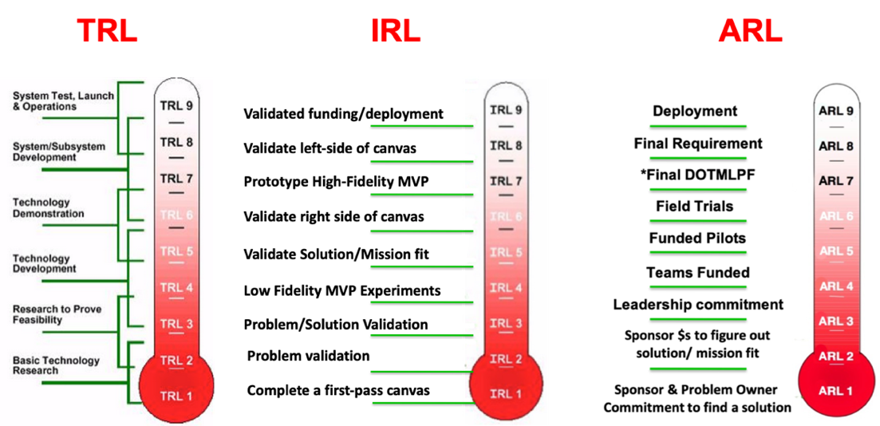
Hard choices must be made between steps
WE GRADE:
The technology readiness level (Technology Readiness Level or TRL)
A team’s ability to deliver the solution (Investment Readiness Level or IRL)
The user’s willingness to adopt the solution (Adoption Readiness Level or ARL)
©2019 BMNT & Steve Blank

Slide 34
Delivering Innovation at Speed & Scale
Pete Newell, BMNT
www.bmnt.com
pnewell@bmnt.com
@ peteranewell
@hacking4defense

